Slide 1
Employee Payroll System

Slide 2
Introduction
The Employee Payroll System is a software application designed to manage and automate all payroll-related activities in an organization. It simplifies the process of calculating employee salaries, deductions, bonuses.
This system helps organizations maintain proper records of employee information, salary details, and payment history while ensuring timely and error-free salary processing. By automating payroll operations, it reduces manual work, saves time, and minimizes the chances of human errors.

Slide 3
Objective and Abstraction
Objective:
• Automate employee and payroll data management.
• Prevent duplicate entries and maintain consistency.
• Ensure accurate payroll calculation with bonuses and deductions.
Abstraction:
The system abstracts database complexity by allowing users to manage employees and payroll records through a user-friendly Java console interface connected to a MySQL database.

Slide 4
Technology Stack
Frontend / Interface: Java Console Application
Backend Logic: Java (OOPs, JDBC)
Database: MySQL
Libraries Used: MySQL Connector/J, Log4J (for logging)
Tools: IntelliJ IDEA, MySQL Workbench
Unit Test : JUnit

Slide 5
Database Overview
1. employees:
• id (Primary Key)
• name
• email (Unique)
• department
• hire date
2. payrolls:
• id (Primary Key)
• employee id (Foreign Key)
• basic salary
• bonus
• deductions
• net salary
• pay date

Slide 6
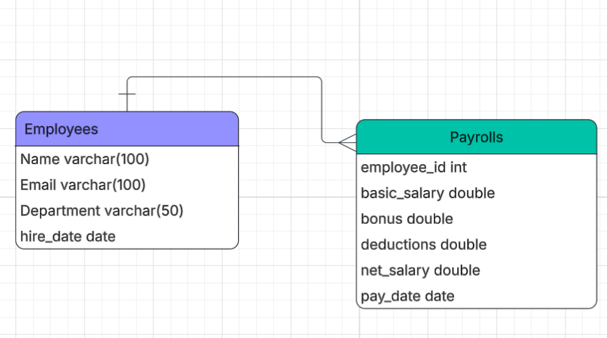
ER Diagram

Slide 7
Future Enhancements
• Add a GUI using JavaFX or React for better usability.
• Implement authentication for HR/Admin users.
• Generate payroll slips in PDF format.
• Host the system on a cloud database (AWS RDS / Azure SQL).

Slide 8
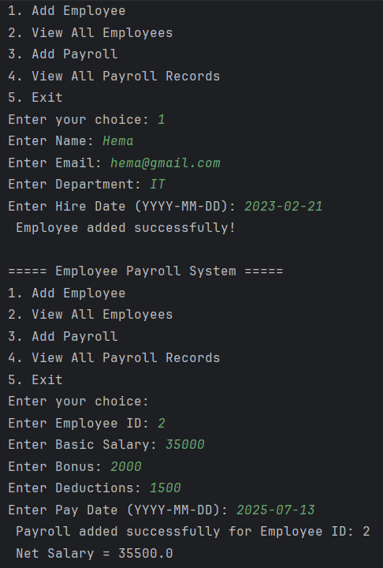
Output

Slide 9
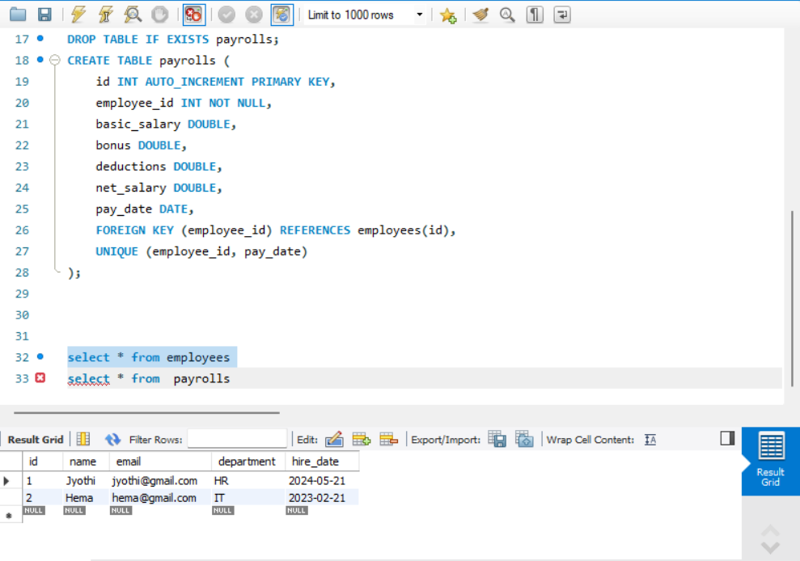
Database

Slide 10
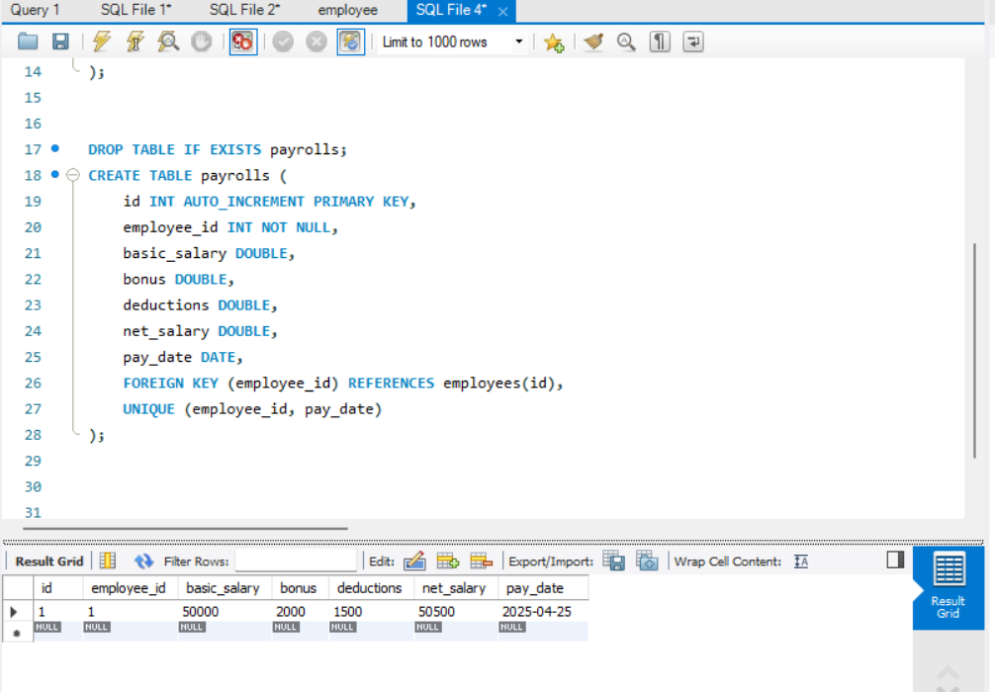
Database

Slide 11
Conclusion
The Employee Payroll System efficiently manages employee and payroll information with minimal errors. It demonstrates strong database relationships, Java–MySQL integration, and adheres to clean coding practices.

Slide 12


